Slide 1
“The First Lesson of the New Academic Year” - Protecting health
（PPT） example of “The First Lesson of the New Academic Year” (Kindergarten)
Notes:
Explanation:
This “example” is for the reference of schools only. School should design the specific teaching content of “The First Lesson of the New Academic Year”according to the age characteristics, physical and mental development regulation, existing experience of students studying in different grades as well as the school-based characteristics.
Target of this example: K2 students
Selection of topics: With the theme of health and hygiene education related to epidemic prevention, the name of this lesson is set as “The First Lesson of the New Academic Year - Protecting health”.

Slide 2
（PPT） example of “The First Lesson of the New Academic Year” (Kindergarten)
Hello kids, How are you?
Do you know me?
（Source of picture: Education and Youth Affairs Bureau of the Macao SAR Government）
Notes:
Explanation:
The 3 videos about the “Green Leaf Hero” presented on the special DSEJ webpage （https://portal.dsej.gov.mo/webdsejspace/site/studyarrange/index.jsp?con=video）are the core of this “example”. Therefore, the design has taken Green Leaf Hero as the leading role, and the teacher will guide students to learn the content of this lesson by role playing.
2. Reference: Corresponding to “The Requirements of Basic Academic Attainments”:
A-2-1 Have the habit of maintaining personal hygiene and the awareness of maintaining environmental hygiene.
A-2-10 Know how to prevent common infectious diseases, be willing to accept physical examination, preventive vaccination and treatment of disease.
3. Basic procedures:
(1) The teacher acts as the Green Leaf Hero and says, “Hello kids, How are your? Do you know me?”
(2)Students answer: …
(3) The teacher acts as the Green Leaf Hero and says, “Ha Ha, I am Green Leaf Hero . Today, I would like to protect health together with everyone. I would like to learn happily together with teachers and classmates.”

Slide 3
（PPT） example of “The First Lesson of the New Academic Year” (Kindergarten)
（ Source of picture: Education and Youth Affairs Bureau of the Macao SAR Government ）
Notes:
Explanation:
Arouse students’ learning motivation by means of their existing experience in epidemic prevention (e.g. wearing masks)
2. Basic procedures:
(1) Teacher acts as the Green Leaf Hero and asks, “Kids, can you tell me what is the name of this that I am wearing on my face? (Teacher points at the mask on his/her face) Why do we need to wear this before we go to work or go to school?”
(2) Students answer:…
(3) Teacher makes conclusion based on students’ answers.

Slide 4
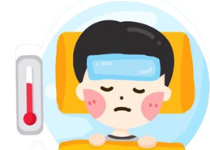
（PPT） example of “The First Lesson of the New Academic Year” (Kindergarten)
I am a coronavirus monster, and my favorite is to spread virus and make children sick.
（ Source of picture: Education and Youth Affairs Bureau of the Macao SAR Government
Notes:
Explanation:
1. Basic procedure:
(1) Teacher acts as the Green Leaf Hero and says with the support of pictures, “It is because there is the coronavirus monster and his favorite is to spread virus and make children sick, therefore, we must protect ourselves and pay attention to health. ”

Slide 5
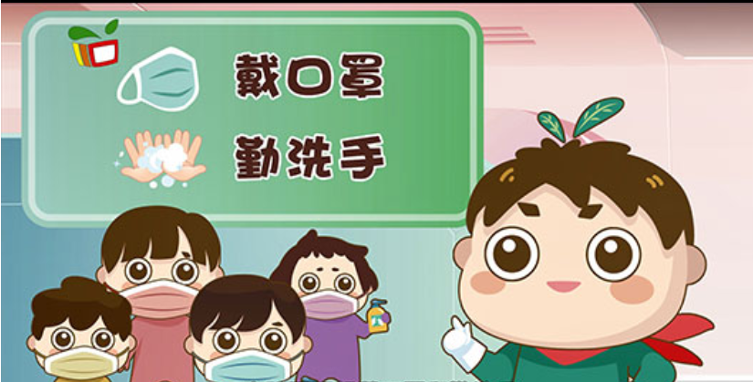
（PPT） example of “The First Lesson of the New Academic Year” (Kindergarten)
（ Source of video: Education and Youth Affairs Bureau of the Macao SAR Government ）
Notes:
Explanation:
Basic procedure:
(1) The teacher plays the role of the Green Leaf Hero and says, “ Now, let me Green Leaf Hero teach everyone how to prevent the new coronavirus monster.
(2) The teacher plays the video.

Slide 6
（PPT） example of “The First Lesson of the New Academic Year” (Kindergarten)
Kids, do you still remember the prevention methods that we have just mentioned ?
（ Source of picture: Education and Youth Affairs Bureau of the Macao SAR Government ）
Notes:
Explanation:
Basic procedure:
(1)Raising questions: Through acting as the Green Leaf Hero, the teacher asks students questions in order to help students recall what they have learnt in the video.

Slide 7
（PPT） example of “The First Lesson of the New Academic Year” (Kindergarten)
Prevention methods are as follows:
Wearing masks
Wash hands frequently
（ Source of picture: Education and Youth Affairs Bureau of the Macao SAR Government ）
Notes:
Explanation:
Basic procedure:
(1) The teacher asks students questions and makes conclusion with the support of pictures.

Slide 8
（PPT） example of “The First Lesson of the New Academic Year” (Kindergarten)
Kids, I still have other methods to prevent the coronavirus monster, do you want to learn?
（ Source of picture: Education and Youth Affairs Bureau of the Macao SAR Government ）
Notes:
Explanation:
Basic procedure:
(1) The teacher acts as the Green Leaf Hero and says, “Kids, I still have other methods to prevent the coronavirus monster, do you want to learn?”

Slide 9
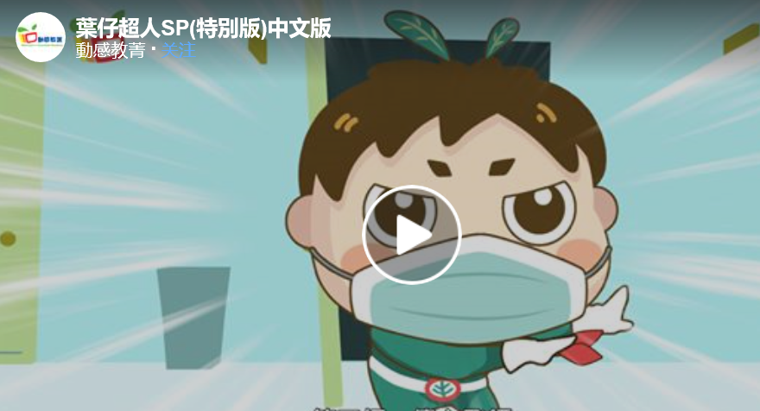
（PPT） example of “The First Lesson of the New Academic Year” (Kindergarten)
（ Source of video: Education and Youth Affairs Bureau of the Macao SAR Government ）
Notes:
Explanation:
Basic procedure:
(1) The teacher plays the video.

Slide 10
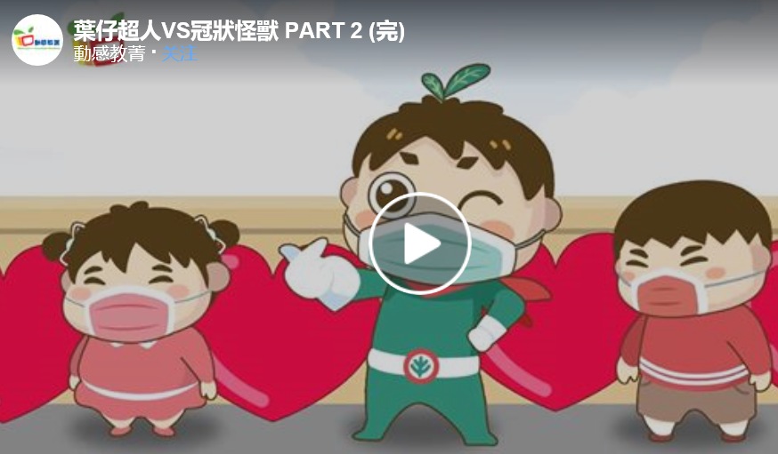
（PPT） example of “The First Lesson of the New Academic Year” (Kindergarten)
（ Source of video: Education and Youth Affairs Bureau of the Macao SAR Government ）
Notes:
Explanation:
Basic procedures:
(1) The teacher acts as Green Leaf Hero and says, “Now, let me continue to teach everyone how to prevent the coronavirus monster in the daily life. ”
(2) The teacher plays the video.

Slide 11
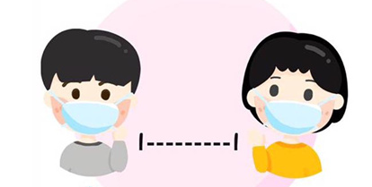
（PPT） example of “The First Lesson of the New Academic Year” (Kindergarten)
Prevention methods are as follows:
（ Source of picture: Education and Youth Affairs Bureau of the Macao SAR Government ）
Notes:
Explanation:
Basic procedures:
(1) The teacher asks students what prevention methods they have learnt with the help of pictures.
(2) Teacher makes conclusion on the prevention methods.
2. The teachers can design suitable rhythms, children's songs (for example: hand washing songs) or games according to different prevention methods to deepen children's learning experience.

Slide 12
（PPT） example of “The First Lesson of the New Academic Year” (Kindergarten)
（ Source of picture and video: Education and Youth Affairs Bureau of the Macao SAR Government ）
Notes:
Explanation:
Basic procedure:
(1) The teacher acts as the Green Leaf Hero and says, “Kids, as long as we take precautions in our daily life, the coronavirus monster cannot make us sick.”

Slide 13
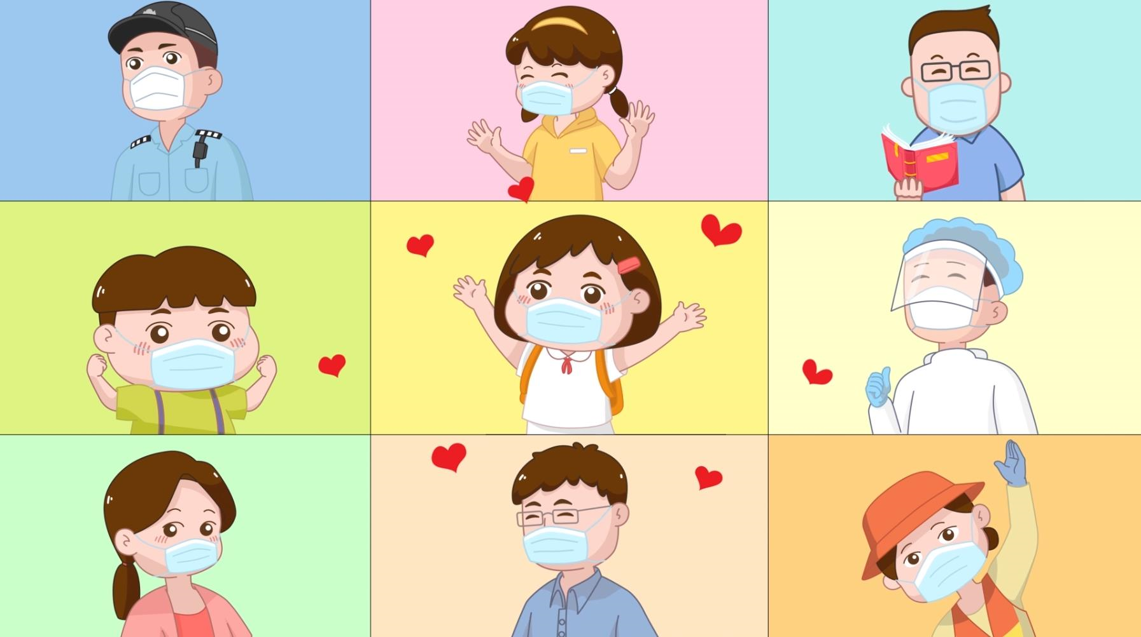
（PPT） example of “The First Lesson of the New Academic Year” (Kindergarten)
（ Source of picture and video: Education and Youth Affairs Bureau of the Macao SAR Government ）
Notes:
Explanation:
Basic procedure:
(1) The teacher acts as the Green Leaf Hero and says, “Finally, let’s recall our experience in the past few months and express our gratitude towards those who have been working hard to protect our health!”

Slide 14
（PPT） example of “The First Lesson of the New Academic Year” (Kindergarten)
In this new school year, let me, Green Leaf Hero protect health and fight against the coronavirus monster together with all the children.
（ Source of picture: Education and Youth Affairs Bureau of the Macao SAR Government ）
Notes:
Explanation:
Basic procedure:
(1) The teacher acts as the Green Leaf Hero and makes conclusion.

Slide 15
（PPT） example of “The First Lesson of the New Academic Year” (Kindergarten)
Wish you good health and happiness!
（ Source of picture: Education and Youth Affairs Bureau of the Macao SAR Government ）
Notes:
Explanation:
Basic procedure:
(1) The teacher acts as Green Leaf Hero and makes conclusion.

